Slide 1
Improvised Iterative Truncated Arithmetic Mean Filter
Prathyusha Surampudi Venkata
A Thesis

Slide 2
Overview
Introduction.
Iterative Truncated Arithmetic Mean (ITM) filter.
Proposed Filter (ITM₃ filter).
Experimental Results.
Conclusion.

Slide 3
Introduction
In digital image processing, certain operations are performed on an image to extract useful information.
Filtering is one of the techniques used to remove noise.
Filters can also sharpen the edges and reduce blurriness.
They can also preserve fine image details.
Depending upon the type of noise in an image, different filters can be used.
Filter operations depends on the operation performed in the filter window.
Mean and Median filters are most commonly used filters.

Slide 4
Thesis Goal
To evaluate the performance of Iterative Truncated Arithmetic Mean (ITM) filter with mean and median filters.
To improve the ITM filter for better performance.
To evaluate the performance of proposed filter with the ITM filters.

Slide 5
ITM filter
ITM filter uses a simple iterative truncation technique.
It owns the merits of both mean and median filters.
The ITM filter doesn't need prior knowledge of the noise.
The filter can attenuate short and long-tailed noises.
Unlike other truncating filters, ITM filter replaces the truncated samples.
The filter uses a dynamic threshold value for truncating the samples.
Filter uses a stopping criterion for terminating the iterations.

Slide 6
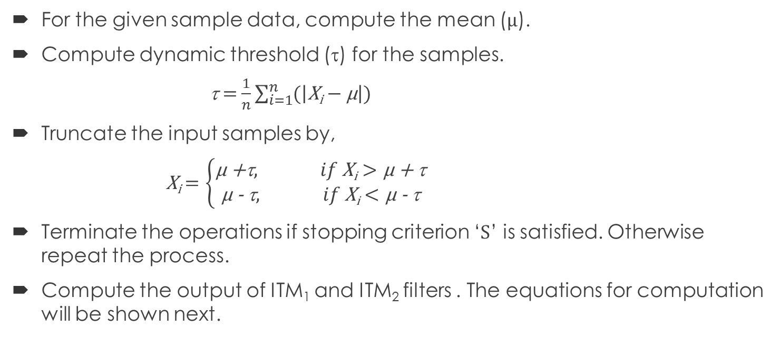
ITM filter operation
For the given sample data, compute the mean (µ).
Compute dynamic threshold (τ) for the samples.
τ $=$ $\frac{1}{n}\sum_{i=1}^{n}{(\left|\text{X}\text{i}−\text{µ}\right|)}$
Truncate the input samples by,
X_{i} $=\left\{\begin{aligned}\text{µ +}\text{t}, if \text{X}\text{i}>\text{µ +} \text{t} \\ \text{µ }\text{− }\text{t}, if \text{X}\text{i}<\text{µ }\text{− }\text{t}\end{aligned}\right.$
Terminate the operations if stopping criterion ‘S’ is satisfied. Otherwise repeat the process.
Compute the output of ITM₁ and ITM₂ filters . The equations for computation will be shown next.

Slide 7
Stopping Criterion
The stopping criterion used is a combination of four criteria. If we assume ‘S’ as the combined stopping criterion and ‘n’ as number of elements in the data.
S = S₁(ε₁) ∨ S₂(ε₂) ∨ S₃(ε₃) ∨ [S₃(ε₃) ∧ S₄(ε₄)]
Criterion 1: S₁(ε₁) : |n_{high} − n_{low}| ≤ ε₁ ; ε₁=1
where, n_{high} is the number of elements in the sampled data greater than mean µ,
n_{low} is the number of elements in the sampled data lesser than or equal to mean µ.
Criterion 2: S₂(ε₂) : k ≥ ε₂
where, ε₂ = 2√n , k is the number of iterations.
Criterion 3: S₃(ε₃) : ∆n_{τ} ≡|n_{τh} − n_{τl} | ≥ ε₃ ; ε₃ = (n − √ n)/2
where, n_{τh} is the number of elements which are larger than µ + τ and
n_{τl} is the number of elements which are smaller than µ − τ .
Criterion 4: S₄ : ∆n (k) = ∆n_{τ} (k − 1)
where, ε₄ = √ n.

Slide 8
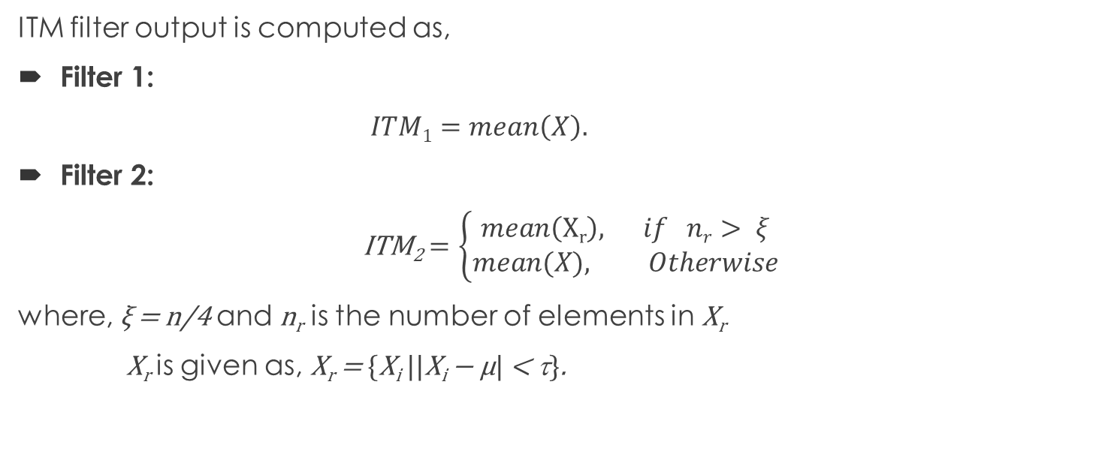
ITM filter operation
ITM filter output is computed as,
Filter 1:
$ITM1=mean\left(X\right).$
Filter 2:
ITM₂$=\left\{\begin{aligned}mean\left(\text{X}\text{r}\right), if nr> ξ \\ &mean(X), Otherwise\end{aligned}\right.$
where, ξ = n/4 and n_{r} is the number of elements in X_{r}
X_{r} is given as, X_{r} = {X_{i} ||X_{i} − µ| < τ}.

Slide 9
ITM filter operation
Let us assume X as sample data, µ as mean, τ as dynamic threshold and S as stopping criterion.
X = { 4, 25, 89, 5, 92, 65, 78, 102, 56, 3, 156, 8}
➔ µ = mean (x ) = 56.9167
➔ t = 40.0833
➔ d_{high} = µ + t = 97 and
➔ d_{low} = µ - t = 16.8333

Slide 10
ITM filter operation (Contd.)
Truncating and replacing sample data gives the final X value
X= {16.8333, 25, 89, 16.8333, 92, 65, 78, 97, 56, 16.8333, 97, 16.8333}
Filter 1:
ITM₁ = mean(X) = 55.5278
Filter 2:
ξ = n/4 = 3
X_{r} = |x- µ |< t ➔ X_{r} ={ 25, 89, 92, 65, 78, 56}
n_{r} > 3 ➔ ITM₂ = mean(X_{r})= 67.5000
Median of the original data is 60.5

Slide 11
Comparison and Analysis with different filters
The Filter is tested for different types of noises and images.
All the noises used are identically distributed with zero mean.
Mean and Median filter are used to compared the ITM₁ and ITM₂ filters.
ITM₁ filter performs better in smooth area with short-tailed and light long-tailed noise.
ITM₂ filter can preserve image details while attenuating impulse noises better.
For accuracy, the MAE over 1000 independent outputs and MSE for 10 independent outputs are used as the performance indicator.

Slide 12
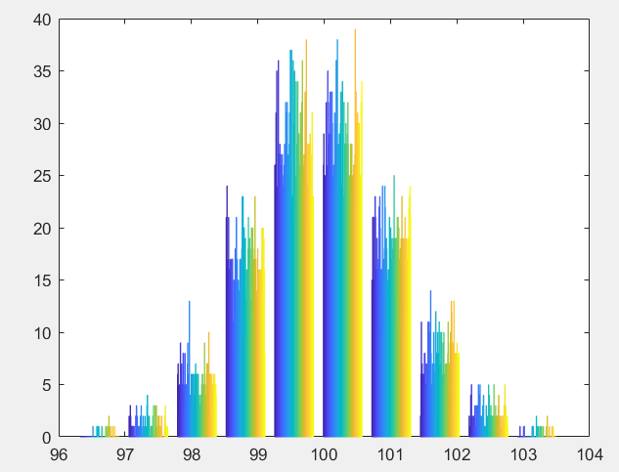
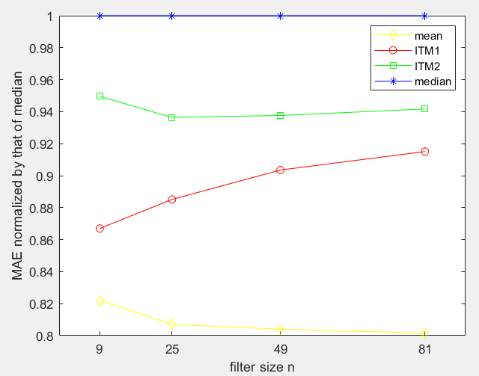
Single type of noise
1) Gaussian noise

Slide 13
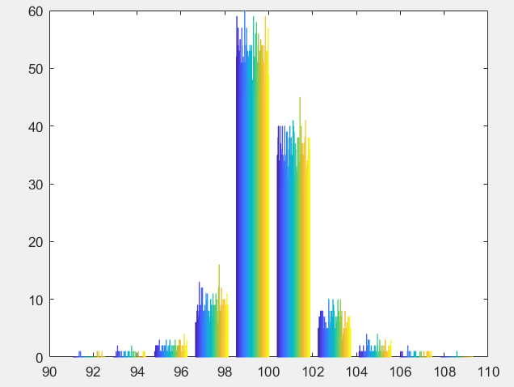
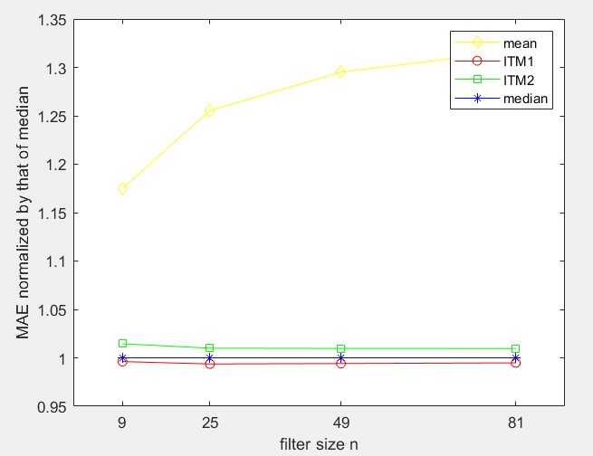
Single type of noise
2) Laplace noise

Slide 14
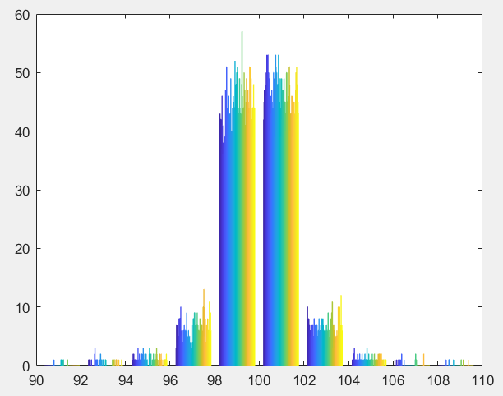
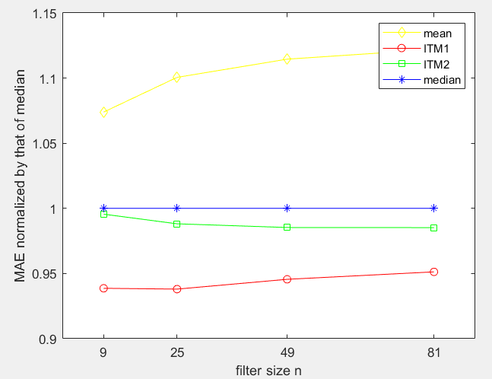
Mixed type of noise
Gaussian and Laplace noise (50% Laplace)

Slide 15
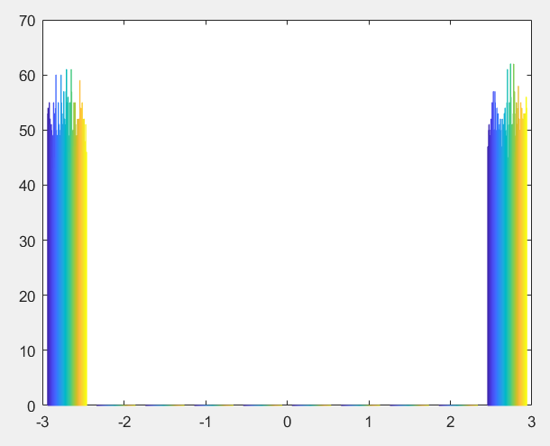
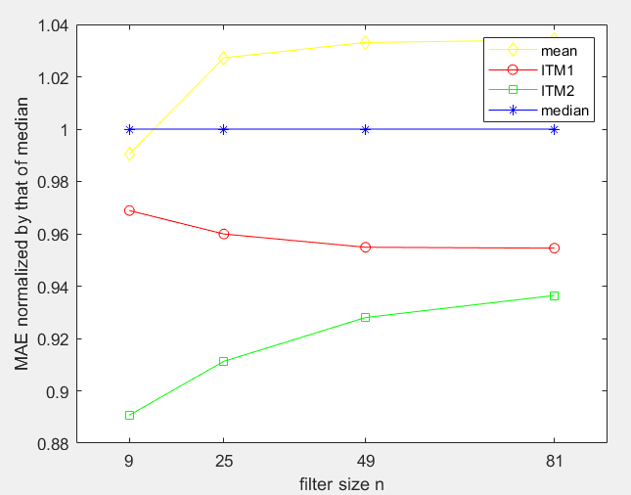
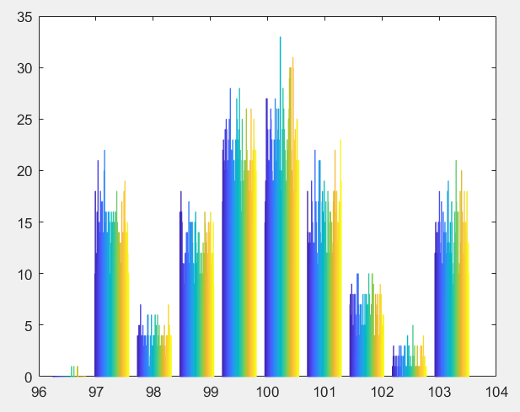
Mixed type of noise
2) Gaussian and Impulse noise (25% impulse)

Slide 16
α-Stable noise
Constant image of size 100 x 100 is corrupted by alpha stable (gamma=10).
a | 0.5 | 0.8 | 1.2 | 1.5 | 1.8
Mean | 210.4157 | 100.4032 | 42.7230 | 23.2344 | 12.6233
Median | 11.6810 | 10.8239 | 12.1287 | 12.6463 | 12.5901
ITM1 | 23.1572 | 13.7089 | 11.6797 | 10.9459 | 10.2116
ITM2 | 16.3721 | 12.5727 | 12.5269 | 12.5644 | 11.8026

Slide 17
Real image corrupted by Gaussian and α-Stable noise
Lena of size 512x512 is corrupted by e-contaminated (0.5) gaussian and alpha stable (gamma=10).
a | 0.5 | 0.8 | 1.2 | 1.5 | 1.8
Mean | 168.2484 | 110.8972 | 78.7190 | 68.2657 | 62.8828
Median | 55.6640 | 53.6999 | 52.2093 | 51.6081 | 51.0055
ITM1 | 57.3673 | 54.2557 | 51.9652 | 50.6081 | 50.1734
ITM2 | 57.8661 | 55.3467 | 53.1891 | 52.1087 | 51.1142

Slide 18
Proposed filter (ITM₃)
The proposed filter is the combination of both the ITM₁ and ITM₂ filters.
ITM₁ is better for Gaussian and Laplace, ITM₂ filter is better for impulse noises.
This filter balances both the ITM₁ and ITM₂ filters and outperforms ITM₂ filter in all the cases.
ITM₃ filter uses the same dynamic threshold and stopping criterion of the original ITM filters.
ITM₃ filter is tested for different types of noise and noise proportions.
Only single and mixed type of noises are considered for evaluation.
The filter is tested on three types of images for accuracy.

Slide 19
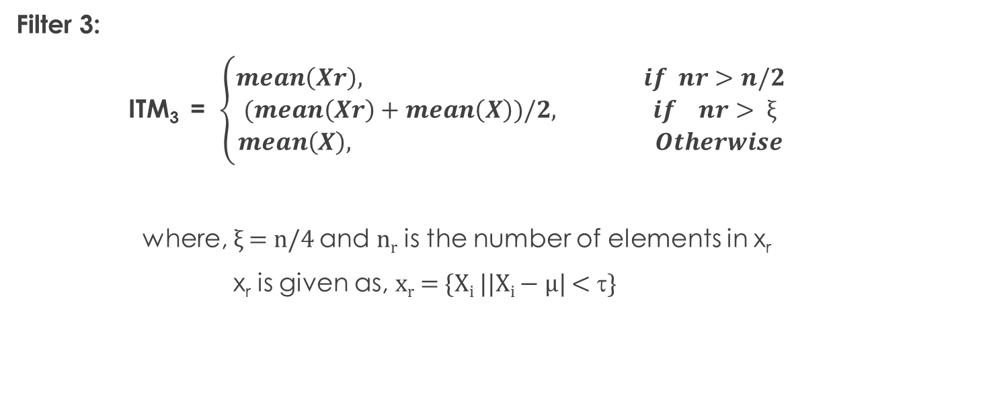
ITM₃ filter operation
Filter 3:
ITM₃ = $\left\{\begin{aligned}mean\left(Xr\right), if nr>n/2 \\ (mean\left(Xr\right)+mean\left(X\right))/2, if nr> ξ \\ mean\left(X\right), Otherwise\end{aligned}\right.$
where, ξ = n/4 and n_{r} is the number of elements in x_{r}
x_{r} is given as, x_{r} = {X_{i} ||X_{i} − µ| < τ}

Slide 20
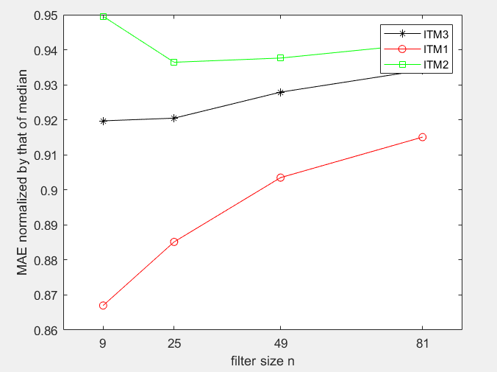
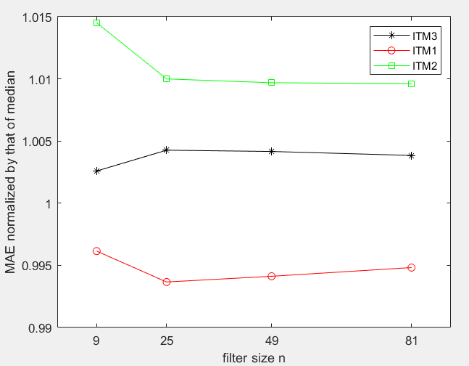
Single type of noise ( constant image)
Gaussian noise 2) Laplace noise

Slide 21
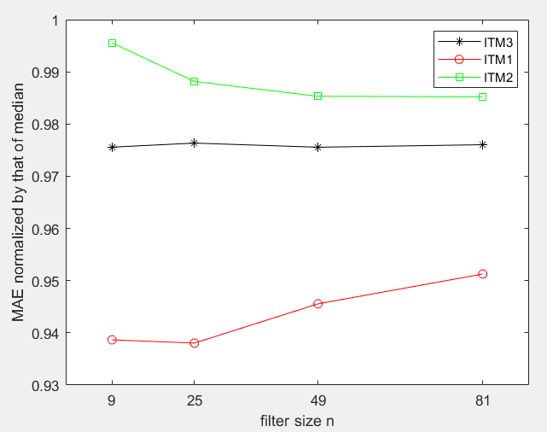
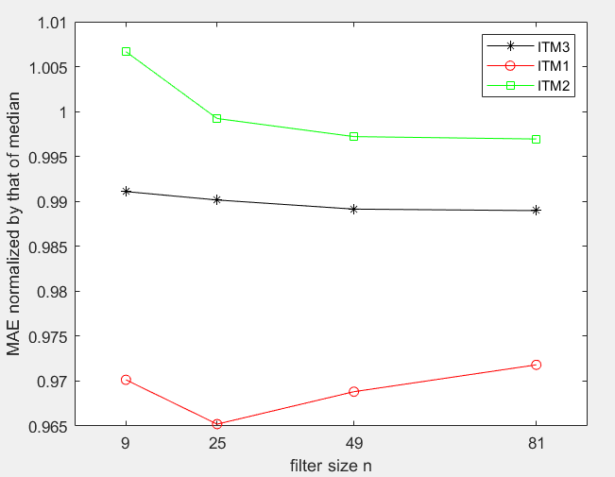
Mixed type of noise (Constant image)
Gaussian and Laplace noise
1) 25% of Laplace noise 2) 50% Laplace noise

Slide 22
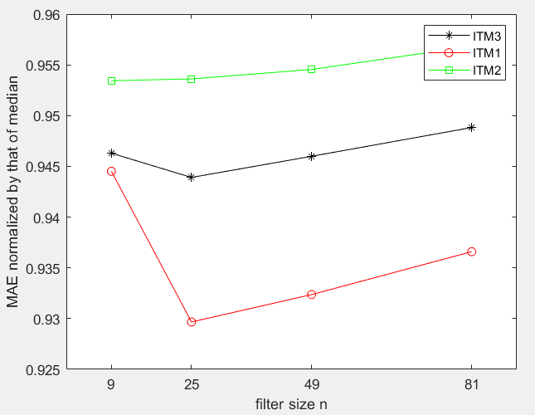
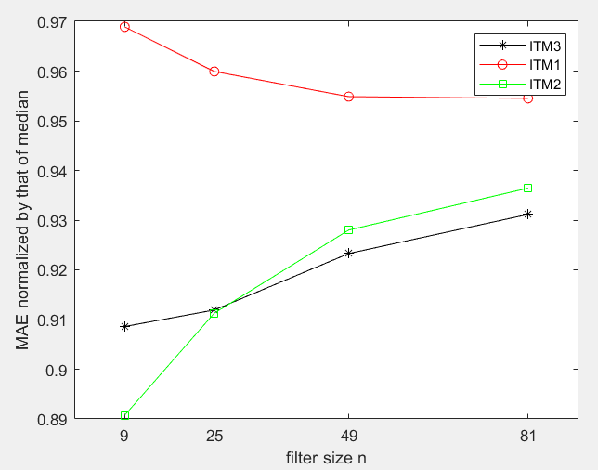
Mixed type of noise (Constant image)
Gaussian and Impulse noise
15% impulse noise 2) 25% impulse noise

Slide 23
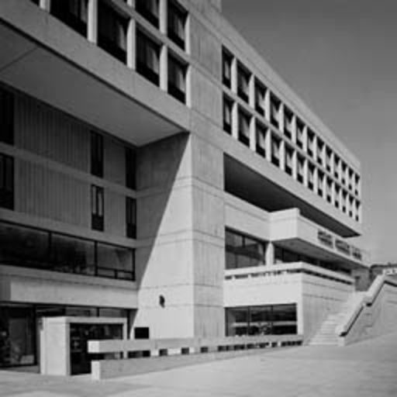
Real images
1) Lena 2) Bank
(for fine image details preservation) ( for evaluating edge preservation)

Slide 24
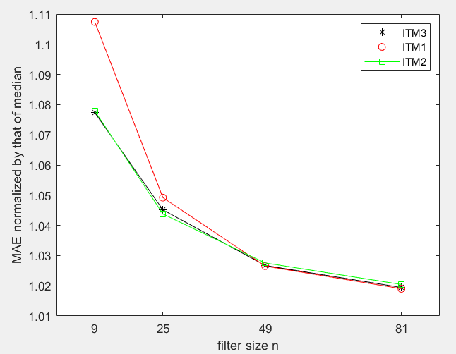
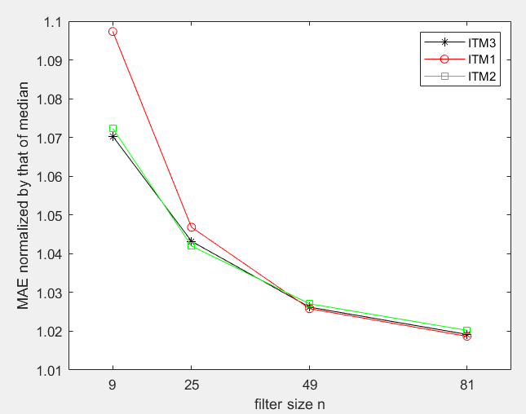
Single type of noise( Lena)
Gaussian Noise 2) Laplace noise

Slide 25
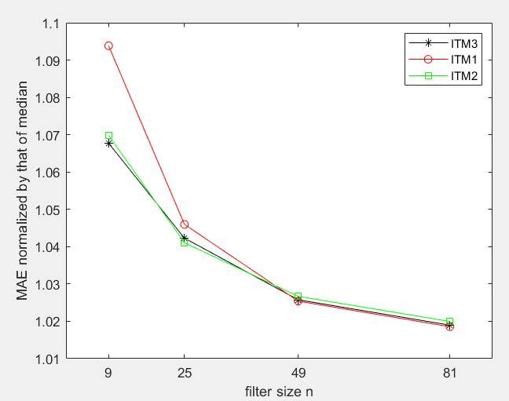
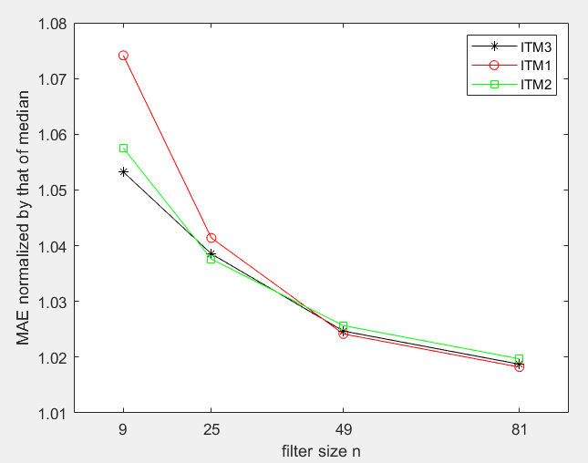
Mixed type of noise (Lena)
Gaussian and Laplace noise 2) Gaussian and Impulse noise
(50% Laplace noise) (25% impulse noise)

Slide 26
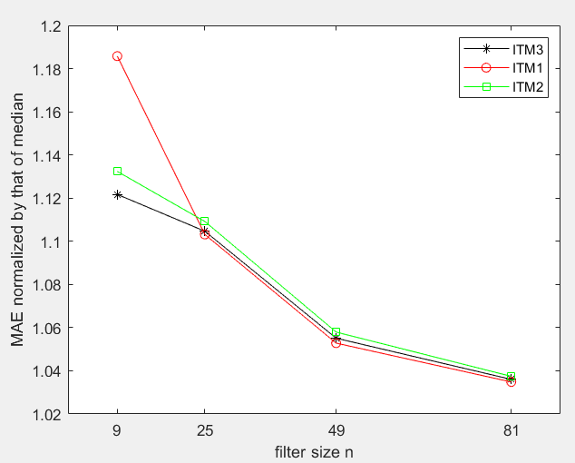
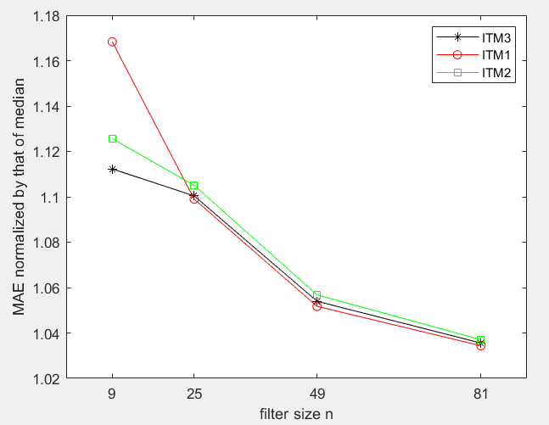
Single type of noise (Bank)
Gaussian noise 2) Laplace noise

Slide 27
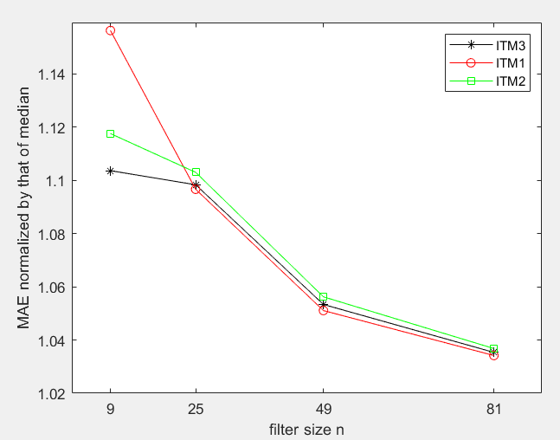
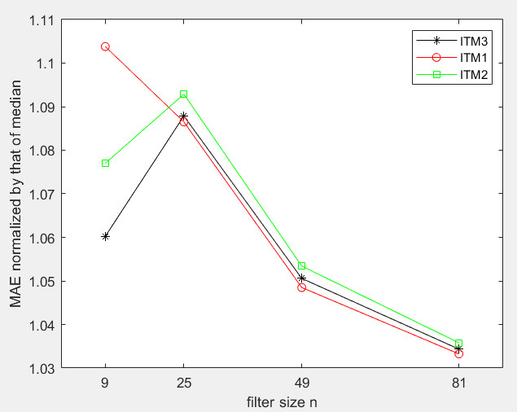
Mixed type of noise ( Bank)
Gaussian and Laplace noise 2) Gaussian and Impulse noise
(50% Laplace noise) (25% impulse noise)

Slide 28
Conclusion
The proposed filter attenuates almost all types of noise better than ITM₂ filter.
The filter outperforms ITM₁ filter while attenuating impulse noise.
It balances both the ITM₁ and ITM₂ filters.
ITM₃ filter is better for all types of images.
It owns the merits of both the ITM₁ and ITM₂ filters and also mean and median filters.
ITM₃ filter can perform better in smooth area with short-tailed noise, light long-tailed noise.
The filter can preserve image structure better while attenuating impulse noise.

Slide 29
Thank You

